Slide 1
Angular
Workshop for Beginners

Slide 2
INTRODUCTION

Slide 3
In next few minutes….
Quick introduction to Angular
Architecture of Angular apps
Set up development environment
Build our first app
Project structure
Angular version history
Editing the first app

Slide 4
What you should know?
HTML
CSS
JavaScript
Typescript(http://www.typescriptlang.org/docs/handbook/basic-types.html)
Any programming language fundamentals (Functions, conditionals, loops etc)
Object Oriented Programming (OOP)

Slide 5
What Tools Required?
NodeJS
Any code editor (preferred- Visual Studio Code)
Google Chrome, firefox (Postman, Firebug)
Git

Slide 6
SINGLE PAGE APPLICATION
What is SPA?
Fits the application on one page
Web application or web site that interacts with the user by dynamically rewriting the current page rather than loading entire new pages from a server
Redraw parts of the UI without refreshing the page
Benefits of SPA
Reduced round trips
Works with low bandwidth scenarios
Load data and views on demand
Highly interactive
SPA Architecture
MVC (Model-View-Controller) pattern
MVVM (Model-View-View Model) pattern
Data binding
Routing

Slide 7
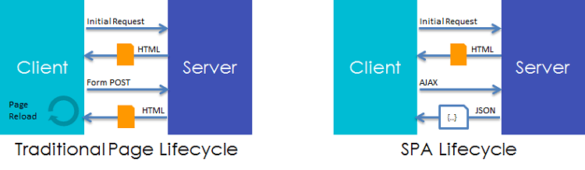
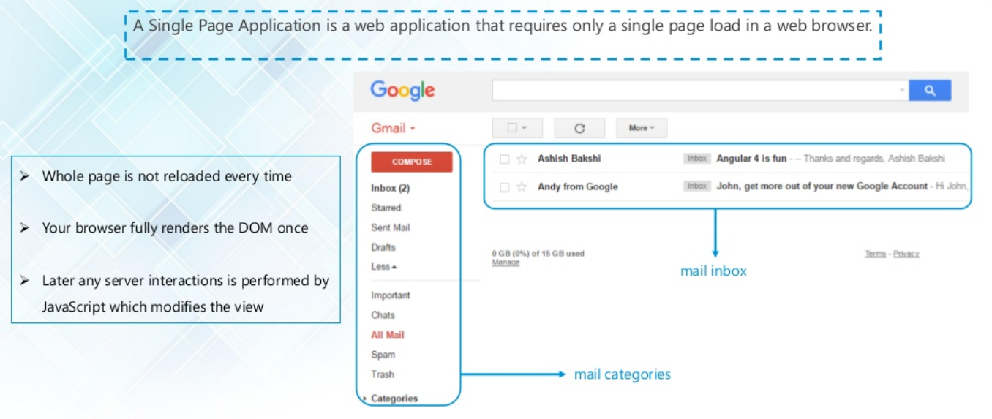

Slide 8
Type of programming languages ANGULAR can Wrote

Slide 9
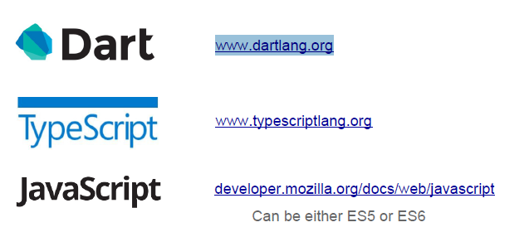
As of Angular 2-4, there are three programming languages we can use.

Slide 10
Dart
Dart is an open source class based, object oriented, optionally typed programming language that allows us to develop browser based one page web applications and server side applications.
The syntax seems friendly both to those who are used to JavaScript and to those who are used to Java\PHP\C#.
We can execute the code either by using a Dart VM or by compiling it into JavaScript
The first web application developed for production using Angular 2 was developed in Dart.
http://news.dartlang.org/2015/11/how-google-uses-angular-2-with-dart.html

Slide 11
TypeScript
TypeScript is a programming language that was developed by Microsoft.
The code we write in TypeScript is compiled into JavaScript. TypeScript is an open source programming language.
TypeScript is a superset of JavaScript. It includes the entire JavaScript programming language together with additional capabilities.
In general, nearly every code we can write in JavaScript can be included in code we write in TypeScript
www.typescriptlang.org

Slide 12
Basic Features of TypeScript
Classes
Allows using common OOP concepts
Compatible with future versions of JavaScript
Interfaces
All JavaScript objects can be described with interfaces
An interface is a programming structure/syntax that allows the computer to enforce certain properties on an object (class)
Generics
Generics is concept used in different programming languages. Generic are used for defining reusable elements such as classes, methods and interfaces.
Modules
Group related interfaces/classes/functions together
Move code out of the global namespace
Lightweight reusable code with no runtime overhead

Slide 13
TypeScript
Basic Types
Any Type
Classes
Interfaces
Modules
Generics

Slide 14
Type Basics
Any
Any is used when it’s impossible to determine the type
Primitive
▷ Doesn’t have separate integers and float/double type. These all are floating point values and get the type ‘number’
▷ boolean - true/false value
▷ string - both single/double quote can be used
▷ No separate char type
▷ void - is used in function type returning nothing
▷ null and undefined - functions as usual
Any
Primitive Types Number Boolean
String
Contextual typing Determine result type from expressions automatically
var n: number;
var |  | a; |  | // | no type -> Any
var |  | s = | "Max"; | // | Contextual typing -> string
n | = | 5; |  | // | valid | because | 5 | is | a number
a | = | 5; |  | // | valid | because | a | is | of type Any
a | = | "Hello"; |  | // | valid | because | a | is | of type Any
n = "Hello";
// compile time error because
// "Hello" is not a number

Slide 15
TypeScript function
Functions are the fundamental building block of any applications in
JavaScript.
JavaScript is a functional programming language, and so supports first class functions.
Allows build up layers of abstraction, classes, information hiding, and modules (JavaScript does not support class, module, private members).
In TypeScript, while there are classes and modules, function still play the key role in describing how to 'do' things.
TypeScript adds some new capabilities to the standard JavaScript
functions to make them easier to work with.
Type Annotation for parameter and return type
Optional and Default Parameter
Rest Parameter
Function Overloads
Allows parameter and return type annotation

Slide 16
Classes
TypeScript classes are basic unit of abstraction very similar to C#/Java classes.
In TypeScript a class can be defined with keyword “class” followed by class name.
TypeScript classes can contain constructor, fields, properties and functions.
TypeScript allows developers to define the scope of variable inside classes as “public” or “private”. It’s important to note that the “public/private” keyword are only available in TypeScript, once it’s converted to JavaScript there is no way to distinguish between the two and both can be called. TypeScript defines a constructor using keyword “constructor”.
Can implement interfaces
Inheritance
Instance methods/members
Static methods/members
Single constructor
Default/Optional parameter
ES6 class syntax

Slide 17
Classes Inheritance
Inheritance is a way to implement IS-A relationship i.e. parent child relationship. Subclass inherits the super class properties like data member, methods. Inheritance is the way of re-usability of code. Let us take the example of parent and child. A child inherits the properties of its parent.
class Employee {
name:string;
constructor(name:string) {
this.name = name;
}
}
class Engineer extends Employee {
display():void {
console.log("Name: "+this.name);
}
}
var obj = new Engineer(“John");
obj.display();
Types of Class Heritage
Implements & Extends
There are two types of class heritage in TypeScript. A class can implement an interface using the implements keyword
and a class can inherit from another class using the extends keyword.

Slide 18
Interface
interface IPerson {
firstName:string,
lastName:string,
sayHi: ()=>string
}
var customer:IPerson = {
firstName:“abs",
lastName:“asd",
sayHi: ():string =>{return "Hi"}
}
console.log("Customer Object Details: ");
console.log(customer.sayHi());
console.log(customer.firstName);
console.log(customer.lastName);
var employee:IPerson = {
firstName:“abd",
lastName:“dfg",
sayHi: ():string =>{return "Hello"}
}
console.log("Employee Object Details: ");
console.log(employee.sayHi());
console.log(employee.firstName);
console.log(employee.lastName);
TypeScript offers support for Interfaces to use them as a contract for classes similar to C#. To declare an interface, we use keyword “interface” followed by the interface name.
Important thing to know about interfaces is that when compiled in JavaScript, interface code is ignored and there is no corresponding JavaScript generated.
An interface is declared with interface keyword. It is a way of implementing 100% abstraction.
It only contains the declaration of the members.
Interface forms a contract with your class that force your class to have all methods defined by the interface must appear in the class.

Slide 19
Modules
Export
A module can export any number of functions, classes or variables. By default, the objects are exported with their original names. We can change this, if required.
A module can have a default exported member as well. Following snippet shows examples of different export statements:
//Inline export with same name
export class MyClass{}
export function myFunc(){}
//Exporting a group of members
export {
MyClass,
myFunc
};
//Rename while exporting
export {
MyClass as AnotherClass,
myFunc as anotherFunc
};
//Default export
export default myMemberToExport;
Import
When a module imports another module, it may import all exported members, some of them or none at all.
The importing module also has the option to rename the importing object. The following snippet shows examples of different import statements:
//Importing all exported objects
import * as module1 from "./module1";
//Importing selected objects
import {MyClass1, MyClass2} from "./module1";
//Importing selected objects and rename them
import {MyClass1 as Module1MyClass1, MyClass2 as Module1MyClass2} from "./module1";
//Importing default export object
import d from "./module1";

Slide 20
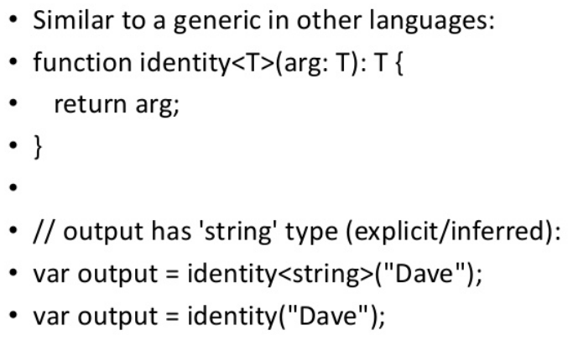
Generics
Gives you the ablility to create a component that can work over a variety of types rather than a single one.
Generics is concept used in different programming languages. Generic are used for defining reusable elements such as classes, methods and interfaces.
It's a function or class that will work with a variety of data types
The function or class uses that data type in several places
class MyContainer<T>
{
private array: T[];
constructor(array: T[])
{
this.array = array;
}
add(item: T) { this.array.push(item);
}
var strContainer = new MyContainer<number>([1]); strContainer.add(2);

Slide 21
Advantages of TypeScript
One of the biggest advantages of Typescript is its code completion and intelligence.
It provides the benefits of optional static typing .Here Typescript provides types that can be added to variables, functions, properties etc.
Typescript has the ability to compile down to a version of JavaScript that runs on all browsers.
Typescript tries to extend JavaScript. Compiler generates JavaScript.
Typescript is a backward compatible version of JavaScript that compiles to pure JavaScript which makes their writing easier and faster.
Typescript is purely object oriented programming which means it is a programming paradigm based on the concepts of objects.
Most important advantage is it offers a “compiler” that can convert to JavaScript equivalent code. And it has a concept of namespace defined by a “module”.

Slide 22
TypeScript Compiler

Slide 23
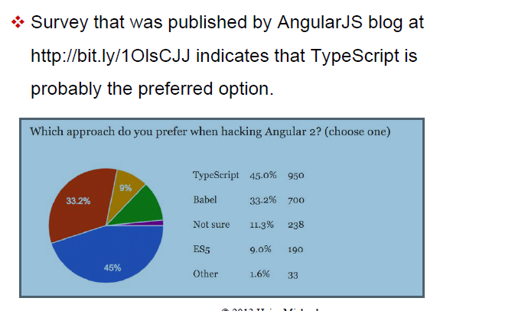
What is The Preferred Language?

Slide 24
WHAT IS ANGULAR?

Slide 25
Angular is a client side framework for building powerful web applications using JavaScript/Typescript.
By default, Angular supports Typescript.
Created and maintained by Google.
The most popular JavaScript framework till date.

Slide 26
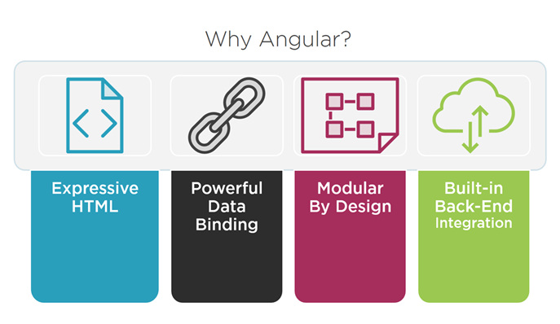

Slide 27
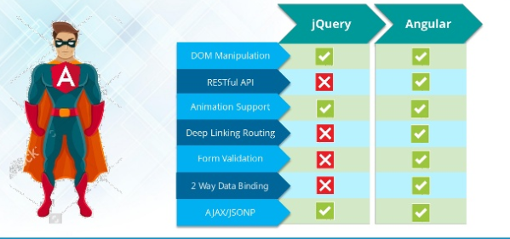

Slide 28
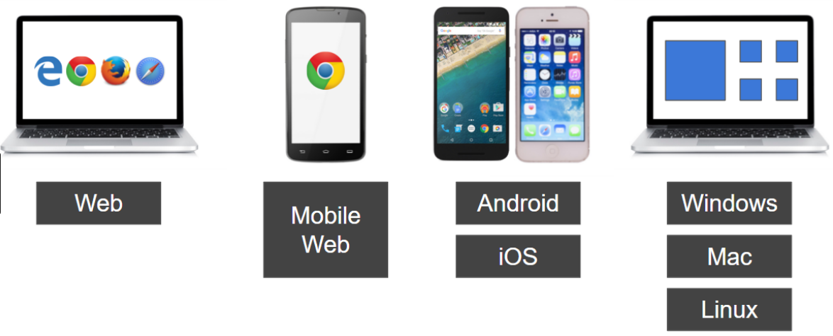
Cross Platform
Angular use modern web platform capabilities to deliver app-like experiences.
High performance and zero-step installation.
Build native mobile apps with Ionic Framework, NativeScript, and React Native.
Create desktop - installed apps across Mac, Windows, and Linux.

Slide 29
Speed and Performance
Angular turns our templates into code that's highly optimized for today's JavaScript machines.
Serve the first view of your application on node.js, .NET, PHP, and other servers for rendering in just HTML and CSS. .
Angular apps load quickly with the new Component Router.
Angular 4 is five times faster than Angular 1

Slide 30
Productivity
Quickly create UI views with simple and powerful template syntax.
Command line tools:
Start building fast
Add components and tests
Then instantly deploy.
Get intelligent code completion, instant errors in popular editors and IDEs.

Slide 31
What Angular is NOT
Not a server side framework/technology
Not a JavaScript library like (jQuery)
Not a Platform or language like (Java/.NET)
Not a Plug-in

Slide 32
What Angular Offers
SPA (Single Page Application)
Dynamic HTML
Powerful templates
Fast rendering
HTTP services
Component based
Form & input handling
Event handling
Routing
Latest JavaScript standards
And many more...

Slide 33
Benefits of using Angular
Angular gives the applications a clean structure
Angular Includes a lot of re-usable code
Angular has better performance.
Angular has more powerful template system.
Angular provide simpler APIs, lazy loading and easier to application debugging.
Angular much more testable.
Angular provides to nested level components.
Angular execute run more than two programs at the same time

Slide 34
Features of using Angular
Two-Way Data Binding This is the coolest feature of the Angular. The Data binding is automatic and fast. changes made in the View is automatically updated in the component class and vice versa
Powerful Routing Support The Angular Powerful routing engine loads the page asynchronously on the same page enabling us to Create a Single Page Applications.
Expressive HTML Angular enables us to use programming constructs like if conditions, for loops etc to render and control how the HTML pages.
Modular by Design Angular follows the modular design. You can create Angular modules to better organize and manage our code base
Built in Back End Support Angular has built in support to communicate with the back-end servers and execute any business logic or retrieve data
Active Community Angular is Supported by google and has a very good active community of supporters. This makes a lot of difference as your queries are quickly resolve

Slide 35




Is Angular only solution?

Slide 36
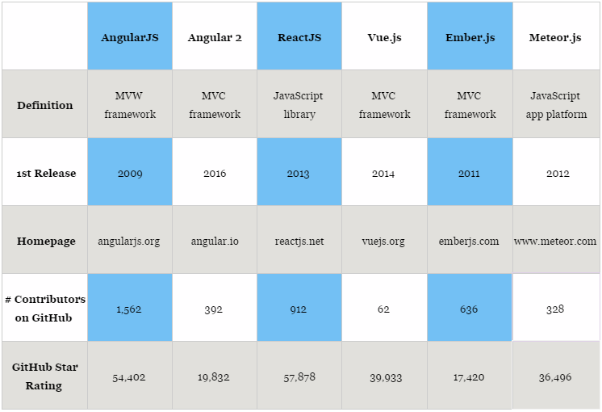
JavaScript framework comparison

Slide 37
ARCHITECTURE
OF
ANGULAR APPS

Slide 38
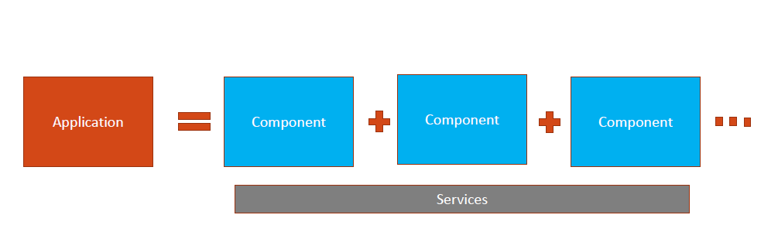
Anatomy of an Angular Application

Slide 39
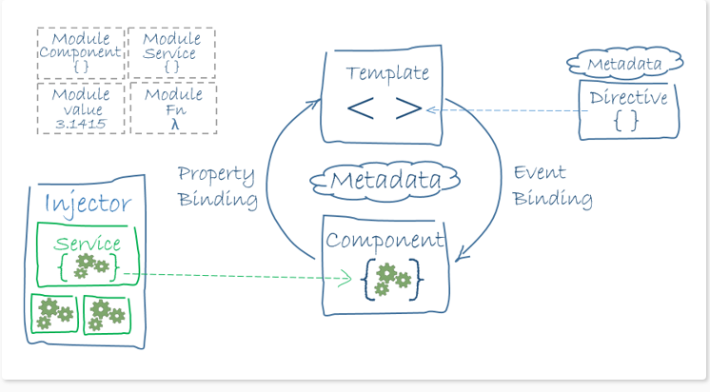
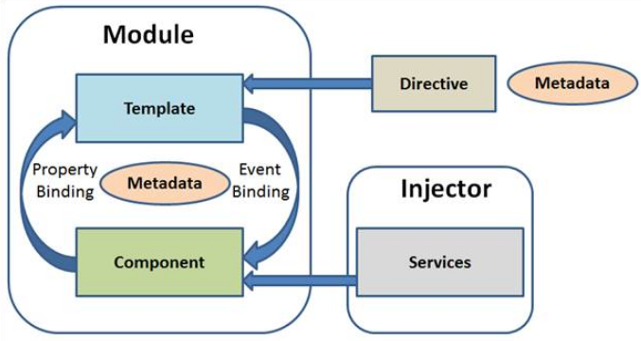
Architecture Diagram

Slide 40
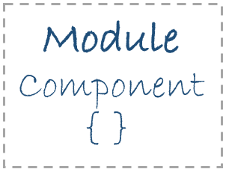


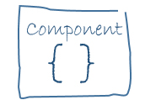
There are 8 key parts to Angular
Modules
Modules are codes of line represented in blocks of code and they perform various type of task. A module sends or does exports some sort of value in the main code, such as class.
Directives
Angular templates are dynamic. When Angular renders them, it transforms the DOM according to the instructions given by directives. A directive is a class with a @Directive decorator.
Metadata
Metadata tells angular how a class should be processed on the screen.
Components
Each component defines a class that contains application data and logic, and is associated with an HTML template that defines a view to be displayed in a target environment.

Slide 41
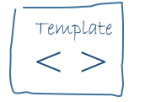
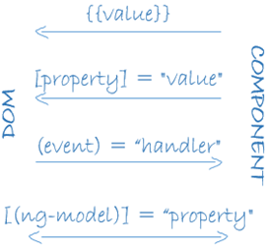


Templates
A template is a form of HTML that tells Angular how to render the component.
Views are typically arranged hierarchically, allowing you to modify or show and hide entire UI sections or pages as a unit.
Data Binding
Angular supports two-way data binding, a mechanism for coordinating parts of a template with parts of a component.
Add binding markup to the template HTML to tell Angular how to connect both sides.
Services
A service is a class containing any function, feature with a defined and specific purpose.
To implement the Business logic there
Dependency Injection
Dependency injection allows to inject dependency as a service throughout the web application

Slide 42
SETTING UP
THE DEVELOPMENT ENVIROMNENT

Slide 43
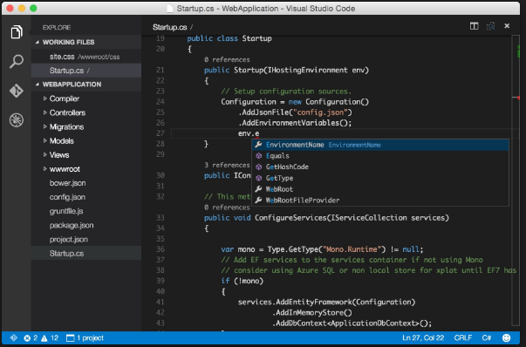
Install Visual Studio Code

Slide 44

Install NodeJS

Slide 45
So What’s this NodeJS?
It’s basically a run time environment to execute the JavaScript code outside the browser.
We use NodeJS, because it provides some most important tools to build Angular projects.
Node allows you to spin up a lightweight web server to host your application locally in your system
We need to use Node and NPM compile them into js file so that we can deploy them in production.
Most of the Angular packages or libraries at GitHub repository (github.com/angular/angular) are distributed as different NPM packages. Node Package Manager is heavily dependent on Node.js.
If you are writing unit tests we need to install test libraries and runner though NPM and executed using Node.

Slide 46
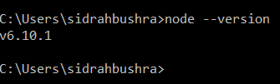
How to check if NodeJS installed or not?
Note: The minimum version required to run the Angular apps is v6.9 and above.

Slide 47
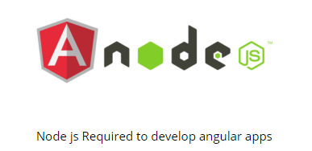
Node Package Manager(npm)

Slide 48
Why npm?
To install 3rd party libraries.
npm is a package manager for Node.js with hundreds of thousands of packages. Although it does create some of your directory structure in the project.
The main goal, as you touched upon, is automated dependency and package management. This means that you can specify all of your project's dependencies inside your package.json
Both Node.js and npm are essential to Angular development.
npm gives you angular cli or ng cli(angular command line interface) . Angular CLI is a great tool for scaffolding your application. So, you don’t need to write boilerplates manually.
With the help of this npm, we are going to install Angular CLI.

Slide 49
What is Angular CLI?
Angular CLI is a command-line interface (CLI) to automate your development workflow.
As the name implies, it is a command line tool for creating angular apps.
It is recommended to use angular cli for creating angular apps as you don't need to spend time installing and configuring all the required dependencies and wiring everything together.
It allows you to:
create a new Angular application
run a development server with LiveReload support to preview your application during development
add features to your existing Angular application
run your application’s unit tests
run your application’s end-to-end (E2E) tests
build your application for deployment to production

Slide 50
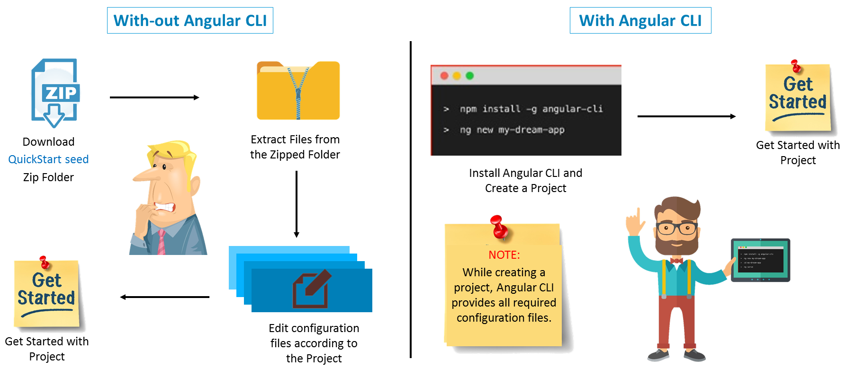

Slide 51
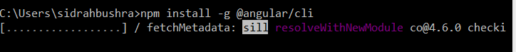
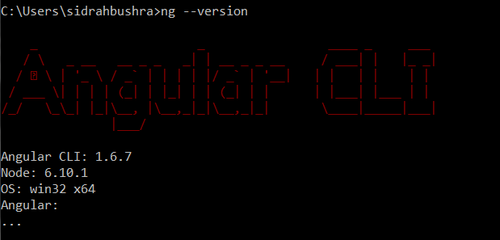
Install Angular CLI
Current working directory
Globally
Package Name
npm install -g @angular/cli

Slide 52
My First Angular App

Slide 53
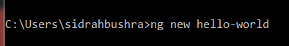
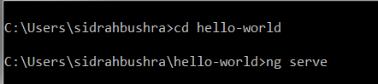
Creating & Running Angular App

Slide 54
Behind the scenes, the following happens:
A new directory hello-world is created
All source files and directories for your new Angular application are created based on the name you specified (my-app) and best-practices from the official Angular Style Guide
npm dependencies are installed
TypeScript is configured for you
The Karma unit test runner is configured for you
The Protractor end-to-end test framework is configured for you
Environment files with default settings are created.

Slide 55
Basic Commands
ng new <app-name>
The Angular CLI makes it easy to create an application that already works, right out of the box.
ng generate <component-name>/<service>/<pipes> or ng g <c>/<s>/<p>/<cl>
Generate components, routes, services, class and pipes with a simple command. The CLI will also create simple test shells for all of these.
here ng stands for angular
g stands for generate
ng serve
To test your app locally while developing.

Slide 56
6. STRUCTURE
OF
ANGULAR PROJECTS

Slide 57
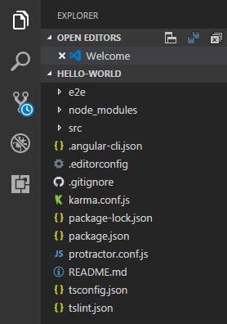

Slide 58
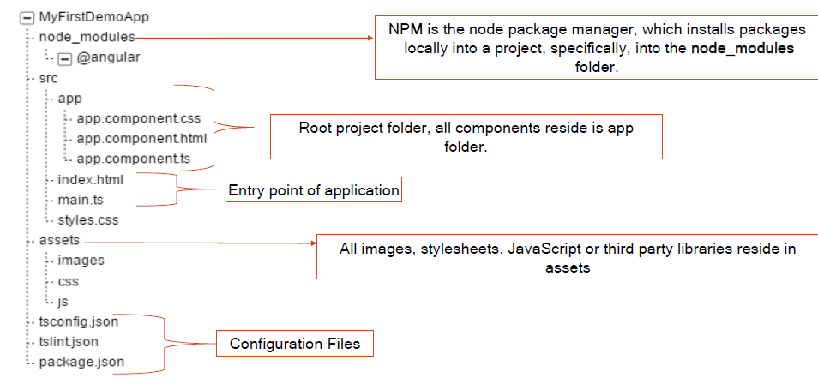
Structure of project

Slide 59
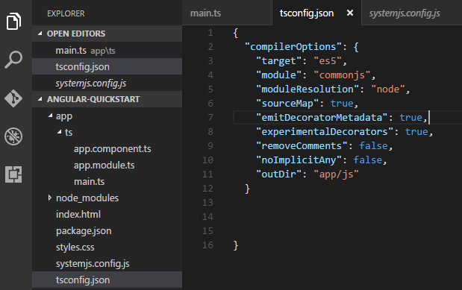
tsconfig.json
It signifies the directory in which it is kept is the root of TypeScript project
The tsconfig.json file specifies the root files and the compiler options required to compile the project

Slide 60
target: the language used for the compiled output
module: the module manager used in the compiled output. system is for SystemJS, commonjs for CommonJS.
moduleResolution: the strategy used to resolve module declaration files (.d.ts files). With the node approach, they are loaded from the node_modules folder like a module (require('module-name'))
sourceMap: generate or not source map files to debug directly your application TypeScript files in the browser,
emitDecoratorMetadata: emit or not design-type metadata for decorated declarations in source,
experimentalDecorators: enables or not experimental support for ES7 decorators,
removeComments: remove comments or not
noImplicitAny: allow or not the use of variables / parameters without types (implicit)

Slide 61
package.json
npm install packages identified in a package.json file.
The CLI ng new command creates a default package.json file for your project.
You can add packages to package.json as your application evolves. You may even remove some.

Slide 62
dependencies and devDependencies
The package.json includes two sets of packages, dependencies and devDependencies.
The dependencies are essential to running the application.
dependencies are used for direct usage in your codebase, things that usually end up in the production code, or chunks of code
The devDependencies are only necessary to develop the application.

Slide 63
Dependencies
The dependencies section of package.json contains:
Angular packages: Angular core and optional modules; their package names begin @angular/.
Support packages: 3rd party libraries that must be present for Angular apps to run.
Polyfill packages: Polyfills plug gaps in a browser's JavaScript implementation.

Slide 64
Angular packages
@angular/animations: Angular's animations library makes it easy to define and apply animation effects such as page and list transitions.
@angular/common: The commonly needed services, pipes, and directives provided by the Angular team.
@angular/core: Critical runtime parts of the framework needed by every application. Includes all metadata decorators, Component, Directive, dependency injection, and the component lifecycle hooks.

Slide 65
@angular/compiler: Angular's Template Compiler. It understands templates and can convert them to code that makes the application run and render. Typically you don’t interact with the compiler directly; rather, you use it indirectly via platform-browser-dynamic when JIT compiling in the browser.
@angular/forms: support for both template-driven and reactive forms.
@angular/http: Angular's old, soon-to-be-deprecated, HTTP client.
@angular/platform-browser: Everything DOM and browser related, especially the pieces that help render into the DOM.

Slide 66
@angular/platform-browser-dynamic: Includes Providers and methods to compile and run the app on the client using the JIT compiler.
@angular/router: The router module navigates among your app pages when the browser URL changes.

Slide 67
Support packages
rxjs: Many Angular APIs return observables. RxJS is an implementation of the proposed Observables specification.
zone.js: Angular relies on zone.js to run Angular's change detection processes when native JavaScript operations raise events.

Slide 68
Polyfill packages
Many browsers lack native support for some features in the latest HTML standards, features that Angular requires. "Polyfills" can emulate the missing features. The Browser Support guide explains which browsers need polyfills and how you can add them.
The default package.json installs the core-js package which polyfills missing features for several popular browser.

Slide 69
DevDependencies
The packages listed in the devDependencies section of the package.json help you develop the application on your local machine.
devDependencies are used for the build process, tools that help you manage how the end code will end up, third party test modules, (ex. webpack stuff)
devDependencies you only need during development or releasing, like compilers that take your code and compile it into javascript, test frameworks or documentation generators.
You don't deploy them with the production application.

Slide 70
@angular/cli: The Angular CLI tools.
@angular/compiler-cli: The Angular compiler, which is invoked by the Angular CLI's build and serve commands.
@angular/language-service: The Angular language service analyzes component templates and provides type and error information that TypeScript-aware editors can use to improve the developer's experience. For example, see the Angular language service extension for VS Code
@types/... : TypeScript definition files for 3rd party libraries such as Jasmine and node.
codelyzer: A linter for Angular apps whose rules conform to the Angular style guide

Slide 71
jasmine/... : packages to support the Jasmine test library.
karma/... : packages to support the karma test runner.
protractor: an end-to-end (e2e) framework for Angular apps. Built on top of WebDriverJS.
ts-node: TypeScript execution environment and REPL(Read-Eval-Print Loop) for node.
tslint: a static analysis tool that checks TypeScript code for readability, maintainability, and functionality errors.
typescript: the TypeScript language server, including the tsc TypeScript compiler.

Slide 72
Points to remember
The default package.json installs more packages than you'll need for your project.
A given package may contain tens, hundreds, even thousands of files, all of them in your local machine's node_modules directory.
By default the Angular CLI build process bundles into a single file just the few "vendor" library files that your application actually needs. The browser downloads this bundle, not the original package files.

Slide 73
Webpack

Slide 74
What is Webpack
The dynamic web applications usually have lots of javascript files. These files are either created by you or it could be third party libraries like jquery/bootstrap etc. We include these in our index.html file using <script> tag.
When a user sends requests to our application, the browser requests and loads these files one at a time. If you have lots of these files, then it will make your application slow.
The solution to this problem is to merge all these files into a one or two files so that the browser can download the entire file in one request. This is where Webpack is used.

Slide 75
Webpack is a module bundler for the web. It is incredibly powerful and enables modularity in angular applications.
Webpack is a powerful module bundler, which scans your web application looking for javascript files and merges them into one ( or more) big file.
Webpack has the ability to bundle any kind of file like JavaScript, CSS, SASS, LESS, images, HTML, & fonts etc. Webpack also comes with Development Server that supports hot module reloading.

Slide 76
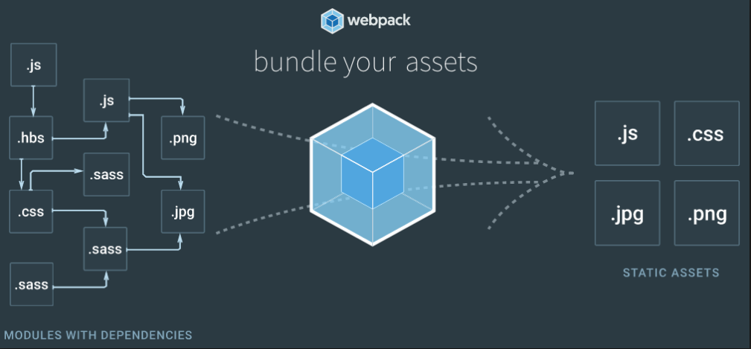

Slide 77
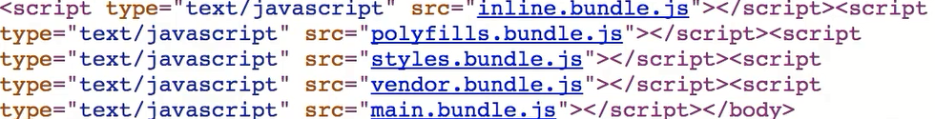
Whenever any source file is modified then automatically webpack is going to refresh the browser without your intervention. A great advantage of it.
Also the generated bundles will be injected into the index.html file during run time.

Slide 78
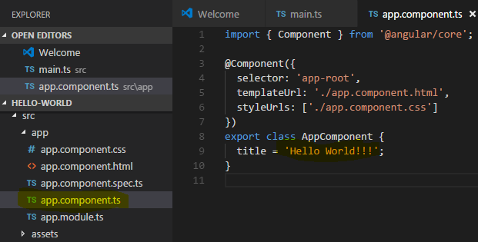
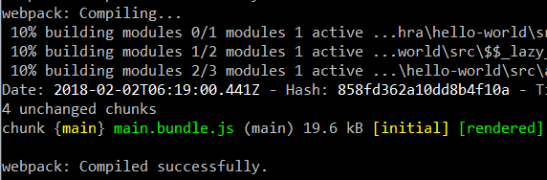
How webpack works behind?

Slide 79
Points to remember
Webpack is a tool for bundling application source code in convenient chunks and for loading that code from a server into a browser.
A bundle is a JavaScript file that incorporates assets that belong together and should be served to the client in a response to a single file request. A bundle can include JavaScript, CSS styles, HTML, and almost any other kind of file.

Slide 80
Angular Version History

Slide 81
AngularJS vs. Angular
Angular does not have a concept of "scope" or controllers, instead it uses a hierarchy of components as its main architectural concept
Angular has a different expression syntax, focusing on "[ ]" for property binding, and "( )" for event binding
Modularity – much core functionality has moved to modules

Slide 82
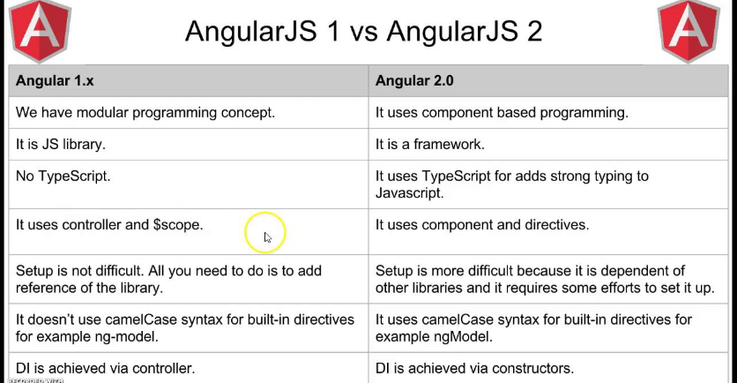

Slide 83
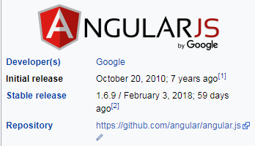
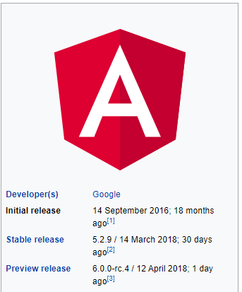
ANGULAR VERSION | DATE | DESCRIPTION
Angular 2 | 14.09.2016 | Initial Version of Angular
Angular 4 | 23.03.2017
Angular 5 | 11.11.2017 | Version 5
Angular 5.2.9 | 14-03-2018 | The Latest Version
Version History
You can read the latest versions at https://github.com/angular/angular/blob/master/CHANGELOG.md

Slide 84
Angular Version Updates
Version 2.0.0
Angular 2.0 was announced at the ng-Europe conference 22-23. September 2014. The drastic changes in the 2.0 version created considerable controversy among developers.[ On April 30, 2015, the Angular developers announced that Angular 2 moved from Alpha to Developer Preview. Angular 2 moved to Beta in December 2015,and the first release candidate was published in May 2016.[The final version was released on September 14, 2016.
Version 4.0.0
On 13 December 2016 Angular 4 was announced, skipping 3 to avoid a confusion due to the misalignment of the router package's version which was already distributed as v3.3.0. The final version was released on March 23, 2017. Angular 4 is backward compatible with Angular 2.Angular version 4.3 is a minor release, meaning that it contains no breaking changes and that it is a drop-in replacement for 4.x.x.
Features in version 4.3
Introducing HttpClient, a smaller, easier to use, and more powerful library for making HTTP Requests.
New router life cycle events for Guards and Resolvers.
Four new events:
GuardsCheckStart, GuardsCheckEnd, ResolveStart, ResolveEnd join the existing set of life cycle event such as NavigationStart. Conditionally disable animations.
Version 5.0.0
Angular 5 was released on November 1, 2017.Key improvements in Angular 5 include support for progressive web apps, a build optimizer and improvements related to Material Design.
Future releases (Version 6.0.0)
Angular 6 release will be pushed back to March or April 2018, with Angular 7 showing up in September or October 2018. Each version is expected to be backward-compatible with the prior release. Google pledged to do twice-a-year upgrades.

Slide 85
What happened to Angular v3?
Angular 2 has been a single repository, with individual packages downloadable through npm with the @angular/package-name convention. For example @angular/core, @angular/http, @angular/router so on.
Considering this approach, it was important to have a consistent version numbering among various packages. Hence, the Angular team skipped a major version 3.
It was to keep up the framework with Angular Router’s version. Doing so will help avoid confusions with certain parts of the framework on version 4, while the others on version 3.

Slide 86
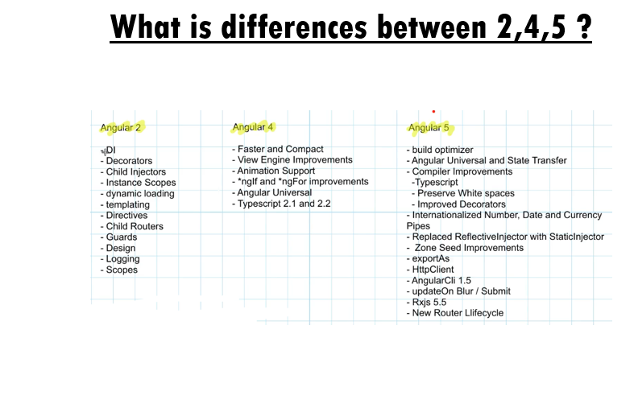

Slide 87
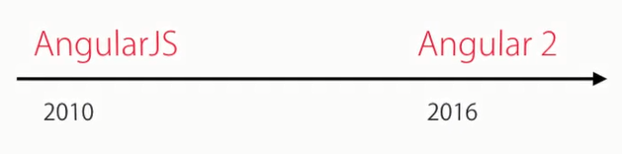
AngularJS or Angular 2 or Angular 4?
AngularJS is completely different than Angular 2 or Angular 4.
Angular 2 or 4 is completely re-written of Angular js
Now its simply Angular.

Slide 88
Angular 4 contains some additional Enhancement and Improvement.
1. Smaller & Faster Apps
2. View Engine Size Reduce
3. Animation Package
4. NgIf and ngFor Improvement
5. Template
6. NgIf with Else
7. Use of AS keyword
8. Pipes
9. HTTP Request Simplified
10. Apps Testing Simplified
11. Introduce Meta Tags
12. Added some Forms Validators Attributes
13. Added Compare Select Options
14. Enhancement in Router
15. Added Optional Parameter
16. Improvement Internationalizationof angular EventEmitter class

Slide 89
Angular recommends the use of Microsoft's TypeScript language, which introduces the following features:
Class-based Object Oriented Programming
Static Typing
Generics
TypeScript is a superset of ECMAScript 6 (ES6), and is backwards compatible with ECMAScript 5 (i.e.: JavaScript). Angular also includes ES6:
Lambdas
Iterators
For/Of loops
Python-style generators
Reflection
Dynamic loading
Asynchronous template compilation
Replacing controllers and $scope with components and directives – a component is a directive with a template
Iterative callbacks provided by RxJS.

Slide 90
BROWSER SUPPORT

Slide 91






Support

Slide 92
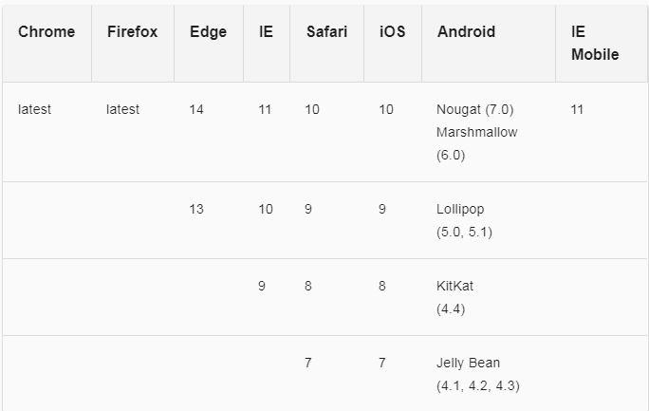

Slide 93
In next few minutes….
Adding bootstrap to our app
Building blocks of Angular apps
Angular Components
Generating components using Angular CLI
Templates, Interpolation & Data Binding
Directives
Services

Slide 94
Adding Bootstrap

Slide 95
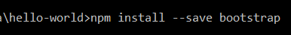
Adding Bootstrap
To install or refer the bootstrap library in our project

Slide 96
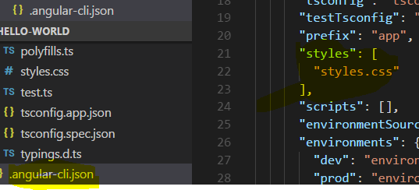
Once bootstrap is installed as a production dependency, we can refer the bootstrap library In 2 ways.
Directly refer the bootstrap cdn path in the index.html
Add the installed bootstrap path in .angular-cli.json

Slide 97
Building blocks of Angular Apps

Slide 98
Modules
Templates
Metadata
Components
Binding
Interpolation & Data binding
Directives
PIPES
Services
Dependency Injection
Routing
Forms
Deployment the app

Slide 99
Modules
Angular apps are modular and Angular has its own modularity system called Angular modules or NgModules.
Every Angular app has at least one Angular module class, the root module, conventionally named AppModule
Angular ships as a collection of JavaScript modules. You can think of them as library modules.
Each Angular library name begins with the @angular prefix
You install them with the npm package manager and import parts of them with JavaScript
Will help us to organize our code, grouping the elements with related features, making them more reusable.
Import statements.

Slide 100
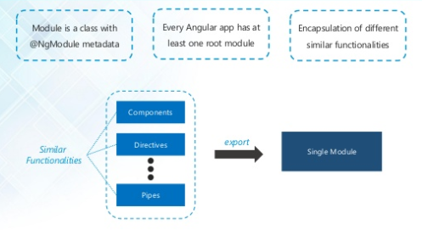

Slide 101
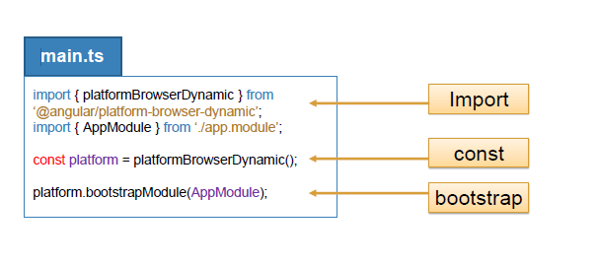
BootStrapping
Angular Modules help organize an application into cohesive blocks of functionality.
Root module needs to import the BrowserModule from @angular/platform-browser to the imports array.
PlatformBrowserDynamic - contains the client side code that processes templates

Slide 102
What is AppModule
AppModule is the root module which bootstraps and launches the angular application. You can name it anything you want, but by convention it is named AppModule.
It imports 2 system default modules –
BrowserModule - Every application that runs in a browser needs this module. In a later in this course we will discuss NgIf and NgFor directives which are also provided by this module.
NgModule - @component decorator adds metadata to an angular component class, similarly @NgModule decorator adds metadata to the angular module class a class is decorated @component decorator then that class becomes an angular component. Similarly if a a class is decorated with @NgModule decorator then that class becomes an angular module.

Slide 103
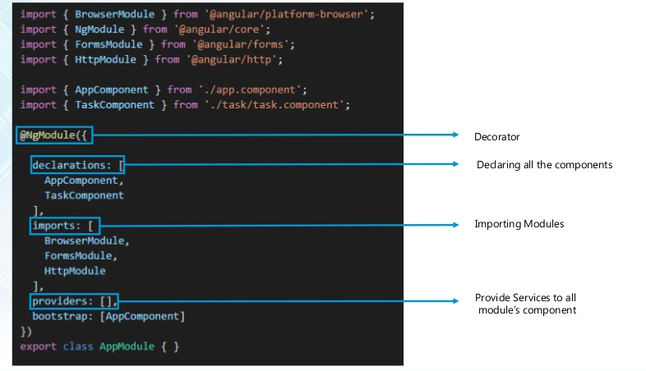

Slide 104
Properties of the @NgModule decorator
imports - Imports the BrowserModule required for an angular application to run in a web browser
declarations - Contains the components registered with this module. In our case we have two - AppComponent and EmployeeComponent
bootstrap - Contains the root component that Angular creates and inserts into the index.html host web page

Slide 105
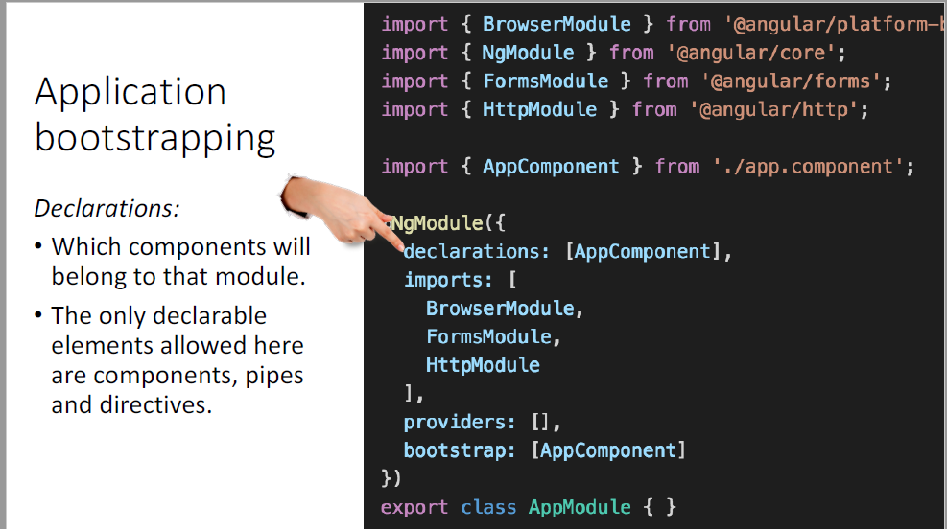
Application bootstrapping

Slide 106
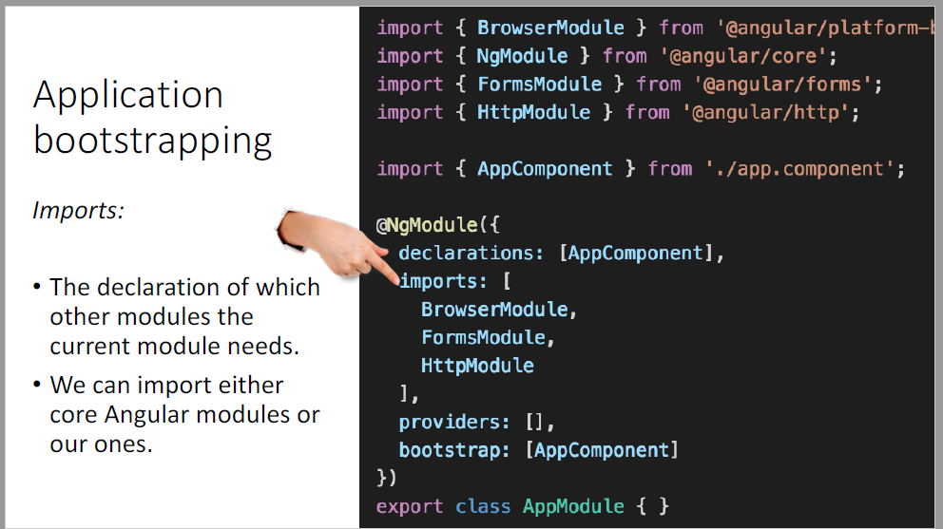

Slide 107
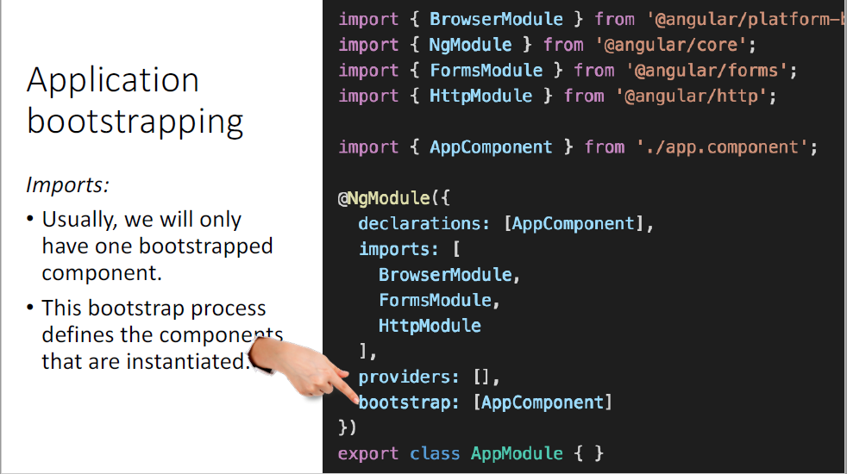

Slide 108
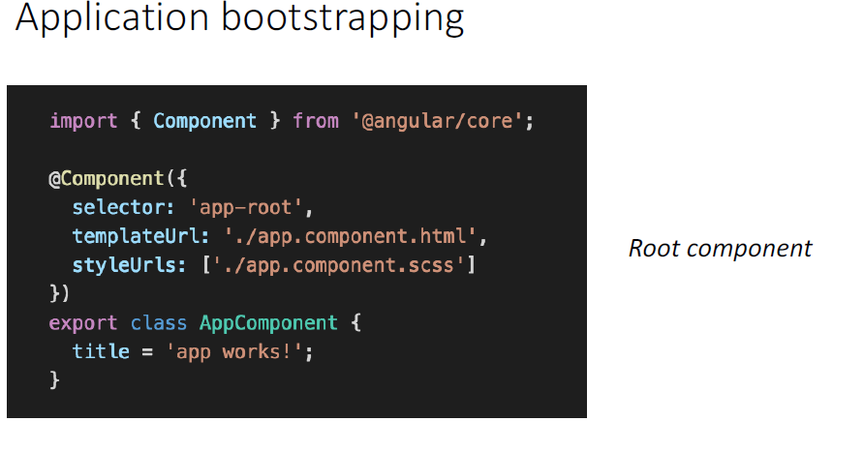
Root component

Slide 109
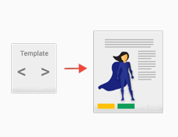
Templates
HTML to tell Angular how to render a component
Include data binding as well as other components and directives
Leverages native DOM events and properties
A template looks like regular HTML, except for a few differences.

Slide 110
Metadata
Metadata tells Angular how to process a class.
In TypeScript, you attach metadata by using a decorator.
The template, metadata, and component together describe a view.
The metadata in the @Component , @Directive tells Angular where to get the major building blocks you specify for the component.
Apply other metadata decorators in a similar fashion to guide Angular behavior. @Injectable,
@Input and @Output are a few of the more popular decorators.

Slide 111
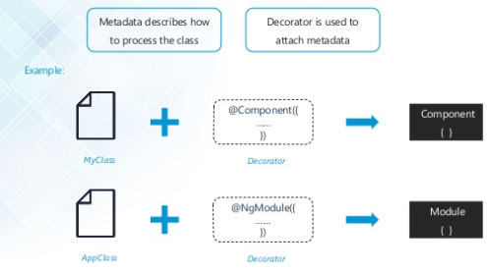

Slide 112
Components
At the heart of every angular app we have one or more components. In fact in a real world app, we have tens or hundreds of components.
Components are the fundamental building block of Angular applications.
Components are the most basic building block of an UI in an Angular application.
An Angular application is a tree of Angular components. Angular components are a subset of directives.
Components are defined using the @component decorator. A component has a selector, template, style and other properties, using which it specifies the metadata required to process the component.

Slide 113
Component Benefits
Reusability.
Complexity.
Legibility – Easily under standable
Testability.
A class, which is where your component logic is stored.

Slide 114
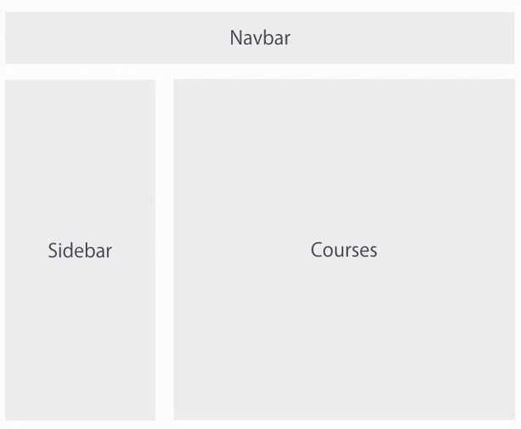

Slide 115
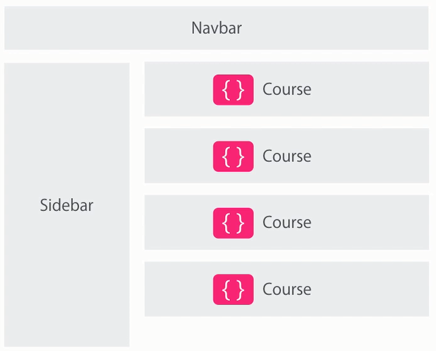

Slide 116


Slide 117



Slide 118

The Components consists of three main building blocks
Template
Class
MetaData

Slide 119
Template (View)
The template defines the Layout of the View and defines what is rendered on the page. Without the template, there is nothing for Angular to render to the DOM.
The Templates are created with HTML. You can add Angular directives and bindings on the template.
There are two ways you can specify the Template in Angular.
Defining the Template Inline
Provide an external Template

Slide 120
Class
The class is the code associated with Template (View). The Class is created with the Typescript, but you can also use javascript directly in the class. Class Contains the Properties & Methods.
The Properties of a class can be bind to the view using Data Binding.
The simple Angular Class
export class AppComponent
{
title : string ="app"
}
The Component classes in Angular are prefixed with the name “Component”, To easily identify them.

Slide 121
Metadata
Metadata Provides additional information about the component to the Angular. Angular uses this information to process the class. The Metadata is defined with a decorator.
A decorator is a function that adds metadata to class, its methods & to its properties. The Components are defined with a @component class decorator. It is @component decorator, which defines the class as Component to the Angular
@Component decorator
A class becomes a Component when Component Decorator is used. A Decorator is always prefixed with @. The Decorator must be positioned immediately before the class definition. We can also build our own decorators. The decorators are Similar to attributes in C#

Slide 122
Important Component metadata properties
Selector
Selector specifies the simple CSS selector, where our view representing the component is placed by the Angular.
Providers
The Providers are the services, that our component going to use. The Services provide service to the Components or to the other Services.
Directives
The directives that this component going to use are listed here.
Styles/styleUrls
The CSS Styles or style sheets, that this component needs. Here we can use either external stylesheet (using styleUrls) or inline styles (using Styles). The styles used here are specific to the component
template/templateUrl
The HTML template that defines our View. It tells angular how to render the Component’s view. The templates can be inline (using a template) or we can use an external template (using a templateUrl). The Component can have only one template. You can either use inline template or external template and not both

Slide 123

Structure

Slide 124

Component Selector – By Element

Slide 125

By Class

Slide 126
Creating Components
3 steps to follow to create a component
Create a component
Register the component in a module
Add an element in an HTML mark up
ng g c myComponent

Slide 127
Problems with manual creation of components

Slide 128


If we forgot any step while creating the components then the application breaks.

Slide 129
Generating Components Using Angular CLI

Slide 130

generate a component in CLI

Slide 131

Create a component

Slide 132


Register the component in a module

Slide 133


Add an element in an HTML mark up

Slide 134
templateURL
We don’t have to write our template code inline with our component code. We can store our HTML template files separately and just refer to them in our component by using the templateUrl property
We point our component to an external template file by using the templateUrl property.

Slide 135
template
We point our component to an internal template file by using the template property.
We can wrote the HTML is in a single line. So this means the code can be rewritten using a pair of single quotes only.
template: `<h1> Hello {{name }} throw error </h1>`

Slide 136
Styling angular components
Component can be easily reused as the styles are defined inline with in the component itself
Application maintenance is also easy as we only have to change the styles in one place
Visual Studio editor features (Intellisense, Code completion & formatting) are available
Styles specified using this approach are local to the component and don't collide with styles used elsewhere in the application.

Slide 137

Component communication
Angular. $scope and $rootScope concepts are removed in Angular
@Input and @Output are two decorators in Angular responsible for communication between two components.
@INPUT
@Input is used to define an input property to achieve component property binding.
@Input decorator binds a property within one component (child component) to receive a value from another component (parent component).
This is one way communication from parent to child.
A component can receive a value from another component using component property binding
@OUTPUT
@Output is used to define output property to achieve custom event binding.
@Output decorator binds a property of a component to send data from one component (child component) to calling component (parent component).
This is one way communication from child to parent component.
@Output binds a property of the type of angular EventEmitter(Listens for something to happen and emits an event when triggered) class

Slide 138
Step 1: Create parent and child components.
ng g c parent
ng g c child
Step 2: Edit the Parent component.ts and html
import { Component, OnInit } from '@angular/core';
@Component({
selector: 'app-parent',
templateUrl: './parent.component.html',
styleUrls: ['./parent.component.css']
})
export class ParentComponent {
title : string;
constructor(){
this.title = 'Parent child communication';
}
}
./parent.component
<child-component></child-component>

Slide 139
Step 3: Share data from parent to child component
In Parent component html
-In child-component.ts
In app component html <app-parent></app-parent>
Parent
<child-component name="i am from parent"></child-component>
import { Component,Input } from '@angular/core';
@Component({
selector: 'child-component',
template: `
<div>
<span>Child Component: </span>
<span>{{name}}</span>
</div>
`
})
export class ChildComponent {
@Input() name: string;
constructor(){}
}
Child

Slide 140


Slide 141
Step 4: Share data from child to parent component.
Edit the child component. ts
Edit the parent.component. Ts and html
<button (click)="shareData()">Share data to parent</button>
Child
export class ChildComponent {
@Input() name: string;
@Output() shareDataToParent = new EventEmitter();
title : string;
constructor(){
this.title = 'Sharing from child to parent';
}
shareData(){
this.shareDataToParent.emit(this.title);
}
}
<child-component name="Angular" (shareDataToParent) = shareDataToParent($event)> </child-component> {{sharedText}}
parent
sharedText:string
shareDataToParent(sharedText:string){
this.sharedText=sharedText
}
Parent component

Slide 142



Slide 143
Angular 4 Lifecycle Hooks
The Angular life cycle hooks are nothing but callback function, which angular invokes when a certain event occurs during the component’s life cycle.
Every component in Angular has its own lifecycle events that occurs as the component gets created, renders, changes it's property values or gets destroyed. Angular invokes certain set of methods or we call them hooks, that gets executed as soon as those lifecycle events gets fired.
Angular 4 has 8 lifecycle hooks that help us in every situation where we would like to write some code on a specific events.
Therefore, I’d recommend understanding Angular 4 lifecycle hooks to create more productive angular apps.
For example
When component is initialized, Angular invokes ngOnInit
When a component’s input properties change, Angular invokes ngOnChanges
When a component is destroyed, Angular invokes ngOnDestroy

Slide 144


Slide 145


Slide 146
ngOnChanges()
ngOnChanges called before ngOnInit() and whenever one/more data-bound input properties change.
It means, whenever any input properties changed than the code under this function will be triggered.
ngOnChange(changes: SimpleChanges){
console.log("ngOnChange called");
console.log(changes);
}
ngOnInit()
ngOnInit is there to give us a signal that Angular has finished initializing the component and now we can perform our needed operations.
Therefore, I consider it as one of the important hooks from a list of Angular 4 lifecycle hooks and very useful, as well.
ngOnInit(){
console.log("ngOnInit called");
}
ngDoCheck()
ngDoCheck is know as a detector because it’s called whenever any changes during the app execution happened.
Also, it’s detect the changes which angular doesn’t able to detect those explicit changes.
In addition, it’s called immediately after ngOnChange and ngOnInit.
ngDoCheck(){
console.log("ngDoCheck called");
}

Slide 147
ngAfterContentInit()
ngAfterContentInit, as name suggested, it responds when the angular app projects content into the component’s view and the view is ready.
It called once after the first ngDoCheck().
ngAfterContentInit(){
console.log("ngAfterContentInit called");
}
ngAfterContentChecked()
ngAfterContentChecked, as it’s name suggested it respond after app checks the content actually projected into the component.
It called after ngAfterContentInit and every subsequent check.
ngAfterContentChecked(){
console.log("ngAfterContentChecked called");
}
ngAfterViewInit()
ngAfterViewInit, responds after app initialized and all the views of component has been ready.
It called once after the first ngAfterContentChecked.
ngAfterViewInit(){
console.log("ngAfterViewInit called");
}

Slide 148
ngAfterViewChecked()
ngAfterViewChecked, responds after app checks all the parent and child views of components.
It called after the ngAfterViewInit and every subsequent call of ngAfterContentChecked
ngAfterViewChecked(){
console.log("ngAfterViewChecked called");
}
ngDestroy()
ngDestory, as it’s name suggested, it will use to do cleanup just before angular app destroys everything.
Furthermore, it will detach the events, unsubscribe the Observables, etc to avoid any memory leaks.
It called just before angular app destors everything like the directive and components.
ngDestroy(){
console.log("ngDestroy called");
}
http://plnkr.co/edit/?p=preview

Slide 149
Interpolation & DataBinding

Slide 150
What is Angular Data Binding
Angular Components are useless if they do not show any dynamic data. They also need to respond to user interactions and react to events.
Data Binding is a process where data is passed from Angular Component to view (Template) and vice versa. The Data Binding is used to bind DOM Elements to Component properties.
Binding can be used display component class property values to the user, change element styles, respond to a user event etc.
The Data binding is not new to Angular. It existed in AngularJs.,

Slide 151
Data Binding
Data binding plays an important role in communication between a template and its component.
Angular supports data binding, a mechanism for coordinating parts of a template with parts of a component. Add binding markup to the template HTML to tell Angular how to connect both sides.
As the diagram shows, there are four forms of data binding syntax. Each form has a direction — to the DOM, from the DOM, or in both directions.

Slide 152


Data Binding | Description
One way data-binding | From Component to View Template
One way data-binding | From View Template to Component
Two way data-binding | From Component to View Template & From View template to Component

Slide 153
Different types of one-way data binding.
Interpolation Binding
Property Binding
Attribute Binding
Class Binding
Style Binding
Event Binding

Slide 154

Interpolation Binding
With interpolation, we place the component property name in the View template, enclosed in double curly braces: {{property Name}}.
In simple words, interpolation is nothing but how we use this binding expression {{}} in our project. We will see that with an example
Interpolation provides the data-binding from component to the View. Interpolation is a one-way binding. It binds from Component Class to the Template.
Notes on Interpolation
Interpolation is one way from component to View
Binding source is a Template expression
Interpolation Expression must result in a string. If we return an object it will not work

Slide 155

Property Binding
Property binding allows us to bind Property of a view element to the value of template expression
Syntax
[property] =’expression’
It is used to bind values of component/model properties to the HTML element.
Depending on the values, it will change the existing behavior of the HTML element.
In property binding, there is source and target. For this example, we can define it as [innerHTML] = 'firstname'. Here, innerHTML is a target that is a property of span tag and source is a component property i.e. firstname.
Eg. <img [src]=“{{imageUrl}}” />
Notes on Property Binding
Non-string return values are allowed

Slide 156
Property Binding Vs Interpolation
Everything that can be done from Property binding can be done using the interpolation. In fact, Angular automatically translates interpolations into the corresponding property bindings before rendering the view.
Interpolation is simple and readable. For example, the h1 title in interpolation is intuitive
<h1> {{ title }} </h1>
And you can achieve the same result using the Property binding using
<h1 [innerText]="title"></h1>
Interpolation requires expression to return a string. If you want to set an element property to a non-string data value, you must use property binding.

Slide 157
Attribute Binding
With attribute binding, we can set the value of an attribute directly. The thing to note is that you must use the attribute binding only when there is no element property there to bind.
Syntax - start with the prefix attr, followed by a dot (.) and the name of the attribute
Eg. [attr.colspan]

Slide 158
Class Binding (Changing a Single Class)
By using the class binding, we can add and remove CSS class names from HTML elements
It is similar to the attribute binding but it starts with the prefix class, optionally followed by a dot (.) and the name of a CSS class: [class. Class-name]
You can add and remove CSS class names from an element's class attribute with a class binding.
Syntax - [class.class-name]

Slide 159
Style Binding (Changing a Single Style)
By using the style binding, we can set inline styles to the HTML element.
One important point here is that it is used to set single line style. If you want to send multiple line style, then Angular provides a good attribute directive called NgStyle.
Syntax
It is similar to the attribute and class binding. It also starts with the prefix style, followed by a dot (.) and the name of a CSS style property: [style. Style-property].

Slide 160
Event binding
Event binding flows or binds the data from an HTML element to a component.
Event handling happen between html to component.
Event binding allows us to work in reverse from property binding. We can send information from the view, to the component class. Such information usually involves a click, hover or typing.
So far we have seen the data flow in one direction like from component to element. But some times we need to send the data from an element to a component. Means clicking the button, typing text box etc. So to meet this, we have a concept called Event Binding.
Notes on Event Binding
Event Binding is one way from View to Component
Binding source is a Template statement
Sample : https://codesandbox.io/s/q9xmpqlo5q

Slide 161
Types of Event Binding
(focus)="myMethod()" // An element has received focus
(blur)="myMethod()" // An element has lost focus
(submit)="myMethod()" // A submit button has been pressed
(scroll)="myMethod()"
(cut)="myMethod()"
(copy)="myMethod()"
(paste)="myMethod()"
(keydown)="myMethod()"
(keypress)="myMethod()"
(keyup)="myMethod()"
(mouseenter)="myMethod()"
(mousedown)="myMethod()"
(mouseup)="myMethod()"
(click)="myMethod()"
(dblclick)="myMethod()"
(drag)="myMethod()"
(dragover)="myMethod()"
(drop)="myMethod()"

Slide 162
Two Way data binding
In simple words, two-way data binding is a combination of both Property Binding and Event Binding.
That is, it provides the bi-directional synchronization between the View and the Component.
Two-way binding is used mainly in data entry forms. Whenever user makes changes in the data, we would like to update our model in the component with the new data and if the model changes, we would like to update the view as well
The Angular uses the combination of Property binding (from component to view) and event binding (from view to component) to achieve the Two-way data binding. This is done so by using the ngModel directive

Slide 163

Binding using [(ngModel)] directive
Note that both square & parentheses are used here. This is now known as Banana in a box syntax. The square indicates the Property binding & parentheses indicates the event binding.
Angular 4 provides the ngModel directive which combines the square brackets of property binding with the parentheses of event binding in a single notation.
When you are using NgModule directive, make sure you have imported Angular system Module called Form Module in app.module.ts file like below.

Slide 164
Angular 2 Input Binding
TextBox
We use two-way data binding with ngModel to bind to the textValue property on the component class.
Two-way binding allows us to use the property to set the initial value of an <input>, and then have the user's changes flow back to the property. We can also change the property value in the code and have these changes reflected in the <input>.
Text Area
Textarea behaves in a similar way to the textbox. Again, we use two-way data binding with ngModel to bind to the textValue property on the component class to keep user and programmatic changes in sync.

Slide 165
Checkbox
The change event is triggered when the user clicks on a checkbox. We use this event to pass a template reference variable into a function to log user action. We can determine whether or not the checkbox has been selected using the checked property of the argument.
We also use the checked property to highlight the selected checkbox labels using class bindings. This uses the styles property to set the text color to OrangeRed for all the selected checkboxes.
Radio
The radio field behaves in a similar way to the checkbox. We use the change event on the <input> element to execute a template statement which passes a template reference variable into a component method.
The value property property of the HTMLInputElement argument is used to log user's selection. This value property corresponds to the value attribute of the HTML <input> element.
Drop-down List
We use an array to populate the drop-down with a list of values. The built-in ngFor directive comes in handy here to loop through the array and set up the option values. For more information on ngFor or any other of the built-in directives see the Angular Built-in Directives tutorial.

Slide 166
Angular Directives

Slide 167
Directive
Angular templates are dynamic. When Angular renders them, it transforms the DOM according to the instructions given by directives.
We can change the appearance, behaviour or a layout of a DOM element using the Directives
“An HTML element or attribute that is used to enhance and extend our HTML”
A directive is a class with a @Directive decorator. A component is a directive-with-a-template; a @Component decorator is actually a @Directive decorator extended with template-oriented features.

Slide 168

Types of Directives

Slide 169


Slide 170
Attribute directive:
They tend to appear within an element tag as attributes do, sometimes by name but more often as the target of an assignment or a binding.
An Attribute or style directive can change the appearance or behaviour of an element.
Attribute directives, as the name goes, are applied as attributes to elements. They are used to manipulate the DOM in all kinds of different ways except creating or destroying them. I like to call them DOM-friendly directives.
Directives in this categories can help us achieve one of the following tasks:
Apply conditional styles and classes to elements
<p [style.color]="'blue'">Directives are awesome</p>
Hide and show elements, conditionally (different from creating and destroying elements)
<p [hidden]="shouldHide">Directives are awesome</p>
Eg. ngModel, ngClass, ngStyle

Slide 171
Structural directives:
Structural directives alter layout by adding, removing, and replacing elements in DOM.
Structural directives are not DOM-friendly in the sense that they create, destroy, or re-create DOM elements based on certain conditions.
This is a huge difference from what hidden attribute directive does. This is because hidden retains the DOM element but hides it from the user, whereas structural directives like *ngIf destroy the elements.
*ngFor and [ngSwitch] are also common structural directives and you can relate them to the common programming flow tasks.
Eg. *ngFor, *ngIf, *ngSwitch

Slide 172
Components vs directives
@Component | @Directive
1. @Component meta-data annotation is used to register the components. | @Directive meta-data annotation is used to register the directives.
2. The components are used to create UI widgets. | The directives are used to add behaviour to existing DOM elements.
3. The components are used to split to application into smaller parts. | The directives are use to design a reusable components.
4. Only one component is used per DOM element. | More than one directive are used per DOM element.
5. In the components, @View, template and templateUrl are mandatory in the components. | The directive do not have @View etc.

Slide 173
Here we will learn…
ngFor
ngIf
ngSwitch
ngStyle
ngClass

Slide 174
*ngFor
NgFor is a structural directive, meaning that it changes the structure of the DOM.
NgFor provides several exported values that can be aliased to local variables.
index: Index of current item.
even: True for an even index.
odd: True for an odd index.
first: True for first item.
last: True for last item.

Slide 175
*ngIF
Here we will understand using NgIf with HTML elements. NgIf is an angular directive that is used to add an element subtree for true value of expression. NgIf is used as *ngIf="expression". Here if "expression" value is either false or null, in both cases the element subtree will not be added to DOM. Now find the below code snippet.
<p *ngIf="isValid">
Data is valid.
</p>
<p *ngIf="!isValid">
Data is not valid.
</p>
Here isValid is a component property that has been initialized as follows.
isValid = true; Hence the output will be Data is valid.

Slide 176


With *ngIf, if the value is True then the element is added to the DOM.
With *ngIf, if the value is False then the element is removed from the DOM.
Important
The difference between [hidden]='false' and *ngIf='false' is that the first method simply hides the element. The second method with ngIf removes the element completely from the DOM. https://plnkr.co/edit/drfec8K80r9PVFUNYnNb?p=preview
We can’t have two structural directives, directives starting with a *, attached to the same element. The below code would not work:

Slide 177
ngSwitch
NgSwitch is a directive which is bound to an expression. NgSwitch is used to display one element tree from a set of many element trees based on some condition. It uses three keywords as follows.
ngSwitch: We bind an expression to it that returns the switch value. It uses property binding.
ngSwitchCase: Defines the element for matched value. We need to prefix it with asterisk (*).
ngSwitchDefault: Defines the default element when there is no match. We need to prefix it with asterisk (*).

Slide 178
*ngIF vs ngSwitch
With NgIf we can conditionally add or remove an element from the DOM.
If we are faced with multiple conditions a cleaner alternative to multiple nested NgIf statements is the NgSwitch series of directives.

Slide 179
ngClass & ngStyle
Creating dynamic styles in web applications can be a real pain. Luckily with Angular, we have multiple ways to create dynamic stylings to our application with ngClass & ngStyle.
The NgClass directive allows you to set the CSS class dynamically for a DOM element.
The NgStyle directive lets you set a given DOM elements style properties.

Slide 180
Custom Directive
ng generate directive fontcolor
When the directive gets created Angular can inject an instance of something called ElementRef, Renderer into its constructor.
Imported the Directive decorator, ElementRef used to get dom element, Renderer to set the element’s style from Angular core module.
import { Directive, ElementRef, Renderer } from '@angular/core’;
The next thing we do is add a constructor to our directive, like so:
export class FontcolorDirective {
constructor(elem: ElementRef, renderer: Renderer) {
}
}

Slide 181
The ElementRef gives the directive direct access to the DOM element upon which it’s attached.
Let’s use it to change the background color of our element to #EEBA33.
ElementRef itself is a wrapper for the actual DOM element which we can access via the property nativeElement, like so:
We use Dependency Injection (DI) to inject the renderer into our directives constructor.
Instead of setting the background color directly via the DOM element we do it by going through the renderer.
renderer.setElementStyle(elem.nativeElement, 'color', '#EEBA33’);

Slide 182
import { Directive, ElementRef, Renderer } from '@angular/core';
@Directive({ selector: '[appFontcolor]' })
export class FontcolorDirective {
constructor(elem: ElementRef, renderer: Renderer) {
renderer.setElementStyle(elem.nativeElement, 'color', '#EEBA33');
}
}
@Directive() decorator will tell the angular that this file used to define custom directive. { selector: ‘[appFontcolor]’ } parameter inside @Directive() is the directive name we are going to use in our template
app.component.html
<div appFontcolor> my custom directive !!! </div>

Slide 183

Pipes
“Allow us to transform or format our data”
Angular 2 comes with a stock of pipes such as DatePipe, UpperCasePipe, LowerCasePipe, CurrencyPipe, and PercentPipe. They are all immediately available for use in any template.
Pipes are just like filters in Angular 1
For example, utilize the uppercase pipe to display a product name in capital letter.

Slide 184
Pipes provided by Angular
CurrencyPipe
This pipe is used for formatting currencies. Its first argument is an abbreviation of the currency type (e.g. "EUR", "USD", and so on)
DatePipe
This pipe is used for the transformation of dates.
DecimalPipe
This pipe is used for transformation of decimal numbers.
The first argument is a format string of the form "{minIntegerDigits}. {minFractionDigits}-{maxFractionDigits}“
PercentPipe
Formats a number as a percent, like so:
UpperCasePipe
This transforms a string to uppercase
LowerCasePipe
This transforms a string to lowercase

Slide 185
JsonPipe
This transforms a JavaScript object into a JSON string
SlicePipe
This returns a slice of an array. The first argument is the start index of the slice and the second argument is the end index.
If either indexes are not provided it assumes the start or the end of the array and we can use negative indexes to indicate an offset from the end

Slide 186
DatePipe
1. 'medium' that is equivalent to 'yMMMdjms'. Find the expression. {{ strDate | date :'medium' }} Output will be: Nov 7, 2016, 9:44:12 AM 2. 'short' that is equivalent to 'yMdjm'. Find the expression. {{ strDate | date :'short' }} Output will be: 11/7/2016, 9:44 AM
3. 'fullDate' that is equivalent to 'yMMMMEEEEd'. Find the expression. {{ strDate | date :'fullDate' }} Output will be: Monday, November 7, 2016

Slide 187
DatePipe Continued…
4. 'longDate' that is equivalent to 'yMMMMd'. Find the expression. {{ strDate | date :'longDate'}} Output will be: November 7, 2016 5. 'mediumDate' that is equivalent to 'yMMMd'. Find the expression. {{ strDate | date : 'mediumDate'}} Output will be: Nov 7, 2016

Slide 188
DatePipe Continued…
6. 'shortDate' that is equivalent to 'yMd'. Find the expression. {{ strDate | date : 'shortDate'}} Output will be: 11/7/2016 7. 'mediumTime' that is equivalent to 'jms'. Find the expression. {{ strDate | date : 'mediumTime'}} Output will be: 9:44:12 AM

Slide 189
DatePipe Continued…
8. 'shortTime' that is equivalent to 'jm'. Find the expression.
{{ strDate | date : 'shortTime'}}
Output will be: 9:44 AM
9. If we do not use any format with date then by default it will be 'mediumDate' which is equivalent to 'yMMMd'. Find the expression.
{{ strDate | date}}
Output will be: Nov 7, 2016

Slide 190
DecimalPipe
DecimalPipe is an angular Pipe API and belongs to CommonModule. DecimalPipe is used to format a number as decimal number according to locale rules. It uses number keyword with pipe operator. Find the syntax.
number_expression | number[:digitInfo]
Find the description.
number_expression: An angular expression that will give output a number.
number : A pipe keyword that is used with pipe operator.
digitInfo : It defines number format.
Now we will understand how to use digitInfo. The syntax for digitInfo is as follows.
{minIntegerDigits}.{minFractionDigits}-{maxFractionDigits}
Find the description.
minIntegerDigits : Minimum number of integer digits. Default is 1.
minFractionDigits : Minimum number of fraction digits. Default is 0.
maxFractionDigits : Maximum number of fraction digits. Default is 3.

Slide 191
PercentPipe
Angular PercentPipe is an angular Pipe API that formats a number as a percentage according to locale rules. It belongs to CommonModule. Find the syntax.
number_expression | percent[:digitInfo]
Find the description.
number_expression: An angular expression that will give output a number.
percent : A pipe keyword that is used with pipe operator and it converts number into percent.
digitInfo: It defines a percentage format. We have described the use of digitInfo in DecimalPipe section. It is used with following syntax.
{minIntegerDigits}.{minFractionDigits}-{maxFractionDigits}

Slide 192
Json Pipe
Angular JsonPipe converts data into JSON string. It uses json keyword with pipe operator to convert any expression result into JSON string. In our example we will create object and array of objects and then we will display them into JSON string using JsonPipe. It is used as follows.
<pre> {{person | json}} </pre>
Where person is an object. JsonPipe is working as a function that is taking arguments of given expression and json keyword and returning JSON string. <pre> tag helps to get JSON string as pretty print.

Slide 193

SlicePipe
SlicePipe creates a new array or string from the given array or string respectively. Slice pipe uses slice keyword with pipe operator. Find the syntax.
array_or_string_expression | slice:start[:end]
SlicePipe using String Expression
Suppose expression is a string as given below.
myStr = "abcdefghijk";

Slide 194
CUSTOM PIPE
We can write our own custom pipe and that will be used in the same way as angular built-in pipes. To create custom pipe, angular provides Pipe and PipeTransform interfaces. Every pipe is decorated with @Pipe where we define the name of our custom pipe. Every pipe will implement PipeTransform interface.
This interface provides transform() method and we have to override it in our custom pipe class. transform() method will decide the input types, number of arguments and its types and output type of our custom pipe. We perform the following steps to create a custom pipe.

Slide 195
Step 1: ng g p pipe-name(ng g p reversechar)
Step 2: Decorate the class using @Pipe.
Step 3: Implement PipeTransform interface.
Step 4: Override transform() method.
Step 5: Configure the class in application module with @NgModule.
Step 6: Ready to use our custom pipe anywhere in application.
import { Pipe, PipeTransform } from '@angular/core';
@Pipe({name: 'reverseChar'})
export class ReversecharPipe implements PipeTransform {
transform(value: string): string {
let newString: string = "";
for (var i = value.length - 1; i >= 0; i--) {
newString += value.charAt(i);
}
return newString;
}
}

Slide 196
Simple search using pipe in Angular
Now create a pipe and name as FilterPipe. Check below code for pipe. ng g p Filter
import { Pipe, PipeTransform } from '@angular/core';
@Pipe({
name: 'FilterPipe',
})
export class FilterPipe implements PipeTransform {
transform(value: any, input: string) {
if (input) {
input = input.toLowerCase();
return value.filter(function (el: any) {
return el.toLowerCase().indexOf(input) > -1;
})
}
return value;
}
}

Slide 197
Add and import in component
import { Component } from '@angular/core';
@Component({
selector: 'app-my-component',
template: `
<div>
<h3> {{title}}</h3>
<input type="text" [(ngModel)]="queryString" id="search" placeholder="Search to type">
<ul>
<li *ngFor="let n of names | FilterPipe: queryString">
{{n}}
</li>
</ul>
</div>`,
styles: ['.selected {color: OrangeRed;}']
})
export class MyComponentComponent {
title:String;
names:any;
constructor(){
this.title = "Angular 4 simple search";
this.names = ['America','India','Pakistan','Australia','England','zimbawbae','Srilanka','South Africa']
}
}

Slide 198
Pure and Impure Pipes
The pure pipe is by default. Every pipe has been pure by default. If you want to make a pipe impure that time you will allow the setting pure flag to false.
Pure Pipes:-
Angular executes a pure pipe only when it detects a pure change to the input value. A pure change can be primitive or non-primitive.
A pure pipe is only called when Angular detects a change in the value or the parameters passed to a pipe.
A pure change is either a change to a primitive input value (String, Number, Boolean, Symbol) or a changed object reference (Date, Array, Function, Object).
@Pipe({
name: myPipe',
pure: true // or no needed to decalrae
})

Slide 199
Impure Pipes:-
Angular executes an impure pipe during every component change detection cycle. An impure pipe is called often, as often as every keystroke or mouse-move.
If you want to make a pipe impure that time you will allow the setting pure flag to false
@Pipe({
name: myPipe',
pure: false
})

Slide 200
Services

Slide 201
What is a Service?
“Used to encapsulate logic that can be used across multiple components”
Services are best used to create, read, update and delete data
Services are fundamental to any Angular application. Components are big consumers of services.
Benefits:
Elements decoupled.
Separated logic.
Reusable.
Testable.

Slide 202


Slide 203

Creating Service
Step 1: ng g service <service name> (ng g service data)
Step 2: Configure service name in providers metadata with @NgModule in module file.

Slide 204

Step 3: Working with the Service File
@Injectable() decorator is a marker used at class level. It tells Injector that this class is available for creation by Injector.
If our service class decorated with @Injectable() has dependency of other service classes, then we need not to worry for its creation and dependency injection will be performed by Injector automatically.

Slide 205

Step 4: Inject Services in Components
The first step requires importing the service at the top of the component. So, in my-component.component :
Next, within the constructor, we have to import it through dependency injection:

Slide 206

Now we can use dataService to access its's associated properties and methods.
Underneath the constructor() { }, let's add the ngOnInit() lifecycle hook, which runs when the component loads:

Slide 207


In the template property of the @Component() decorator, add:

Slide 208
HTTP SERVICE
https://angular.io/api/http/Http
Http Service will help us fetch external data, post, GET etc. We need to import the http module to make use of the http service.
Angular HTTP library provides Http client for server communication. get() is the Http client method that uses HTTP GET method to communicate server using HTTP URL. We need to pass HTTP URL to Http.get()
Http.get() performs a request with HTTP GET method. The syntax is as given below.
get(url: string, options?: RequestOptionsArgs) : Observable<Response>
get() is the method of angular Http API that interacts with server using HTTP GET method. It accepts a HTTP URL and returns Observable instance. RequestOptionsArgs is optiona

Slide 209
Create a SERVICE file
We need import the Service in provider and appModule
providers: [DataService,HttpServiceService]
we have imported the HttpModule from @angular/http and the same is also added in the imports array. - app.moudule file
- import { HttpModule } from '@angular/http';
Service file Add http in to constructor
import { Http } from '@angular/http';
constructor(private _http:Http) {
}
public getData()
{
let _url:string="http://jsonplaceholder.typicode.com/users"
return this._http.get(_url)
}

Slide 210
In Componet File
Add import { HttpServiceService } from '../http-service.service';
Add constructor
constructor(private _httpService:HttpServiceService) {
}
-Subscribe to the Observable and fetch values
this._httpService.getData().subscribe(
res => this.jsonData = res.json()
)

Slide 211
HTTP POST & Error handling
Http.post()
Http.post() performs a request using HTTP POST method. Find the syntax.
post(url: string, body: any, options?: RequestOptionsArgs) : Observable<Response>
url: This is HTTP URL using which we post data to the server.
body: This is the object which we need to post to the server.
options: This is optional. Here we pass the instance of RequestOptionsArgs that uses headers.
Observable<Response>: This is the return type of Http.post()

Slide 212



Slide 213
Routing
Routing basically means navigating between pages. You have seen many sites with links that direct you to a new page. This can be achieved using routing. Here the pages that we are referring to will be in the form of components.
Using routing we maintain separation between the
different parts of our app, easily maintain the state of
our app and protect parts of the app based on specific
rules.
Routing allows you to:
Maintain the state of the application
Implement modular applications
Implement the application based on the roles (certain roles have access to certain URLs)

Slide 214



Slide 215
First of all, Angular Router takes care of the duties of a JavaScript router:
it activates all required Angular components to compose a page when a user navigates to a certain URL
it lets users navigate from one page to another without page reload
it updates the browser’s history so the user can use the back and forward buttons when navigating back and forth between pages.
In addition, Angular Router allows us to:
redirect a URL to another URL
resolve data before a page is displayed
run scripts when a page is activated or deactivated
lazy load parts of our application.

Slide 216
How Angular Router Works
Before we dive into the code, it’s important to understand how Angular Router operates and the terminology it introduces.
When a user navigates to a page, Angular Router performs the following steps in order:
Parse: it parses the browser URL the user wants to navigate to
Redirect: it applies a URL redirect (if one is defined)
Identify: it identifies which router state corresponds to the URL
Guard: it runs the guards that are defined in the router state
Resolve: it resolves the required data for the router state
Activate: it activates the Angular components to display the page
Manage: it manages navigation and repeats the process when a new URL is requested
To remember the 7 steps, you can use the mnemonic PRIGRAM, where each letter represents a step in the routing process:

Slide 217

Configuring Routes

Slide 218
RouterLink and RouterLinkActive
RouterLink is a directive that is used to bind a route with clickable HTML element.
RouterLinkActive is a directive that is used to add or remove CSS classes. When the HTML element with RouterLink binding is clicked then the CSS classes bound with RouterLinkActive will be active. These
In the first link routerLink is bound with a route and routerLinkActive is bound with a CSS class. When this linked will be clicked then the associated CSS class will be activated. In the second link we are binding only routerLink with a parameter directives are used are follows.

Slide 219

RouterOutlet
RouterOutlet is a directive that is used as is to mark where the router displays a view. Find the code snippet.
RouterOutlet directive tells our router where to render the content in the view.

Slide 220

RouterModule - forRoot
RouterModule.forRoot takes the Routes array as an argument and returns a configured router module.
RouterModule.forRoot(routes): creates a routing module that includes the router directives, the route configuration and the router service
RouterModule.forChild(routes): creates a routing module that includes the router directives, the route configuration but not the router service.
The following sample shows how we import this module in an app.routes.ts file.

Slide 221
Create a routing
Step1 : create a route file (app.route.ts)
Step 2: configure Route file
Step 3: Then import our routing configuration in the root of our application.
Step 4: create a components
Step 5 : add a component in Route file
Step 6: add link to app.component.html

Slide 222

Nested Child Routes
Understanding Child Routes

Slide 223

Child Router Outlet
Find the diagram that shows child router outlet. We are using all components of our example in the diagram and by arrow we are showing which component will open in which component's <router-outlet>.

Slide 224
Child Routes Module - Remember
While creating our angular applications, we should follow angular recommended pattern as given below.
1. Each feature area should reside in its own folder.
2. Each area should have its own area root component.
3. Each area root component should have its own router outlet and child routes.

Slide 225
Creating a child routes
Step 1: Create a child component inside parent component folder
ng c birlasoftChennai/branchOne and branchTwo
Step 2: Configuring app.route.ts file
- importing 2 component add children path
Step 3: Configuring router link parent component
Step 4: Run

Slide 226

Forms
In Angular, we can build forms with a template-driven or a model-driven approach. Here you'll learn to create template-driven forms and reactive form using Angular 4.

Slide 227
Usage
Support two-way binding so that the input control values are in sync with the component state.
Keep track of the form state and check whether the current state is valid or not. For instance, if the username has invalid characters, a red border should appear around the input field for the username.
Have a mechanism to display validation errors properly.
Enable or disable certain parts of the form unless some validation criteria are met.

Slide 228



Slide 229

Difference

Slide 230
Template-Driven Forms
template-driven forms place the emphasis on developing a form within an HTML template and handling most of the logic for the form-inputs, data validation, saving, and updating-in form directives placed within that template.
Very less code required because most of the forms related work have been done by the angular framework itself.
Heavy use of the ngModel form directive
FormModule must be imported into app-module.ts
FormModule is available for following package
import { FormsModule } from ‘@angular/forms’;

Slide 231
Two Important Directives for form building:
• NgForm • ngModel
ngForm:
It plays a great role in form building, this angular directive concrete values of all HTML elements of form.
We can say that by using this directive we are capable to create form object.
NgModel:
This directive has used no binding, one-way and two-way data binding.
It is responsible to hold values of HTML elements.
It is also used to validate HTML elements values.

Slide 232
Reactive or Model Driven Forms
In this approach, we have to add an additional layer of complexity and functionality by having you to declare the model of the form in your component class.
We represent the form as a model composed of instances of FormGroups and FormControls.
HTML for our form isn’t automatically created for us in model-driven approach.
Need to write the HTML that represents our form and then explicitly link the HTML form elements to code on our component.
We represent the form as a model composed of instances of FormGroups and FormControls.

Slide 233
Step 1: import ReactiveFormsModule in module
import { FormsModule, ReactiveFormsModule } from '@angular/forms’
Step 2: Add a code in component file.
Step 3: import form group and FormsModule in component file.
https://plnkr.co/edit/5Bb1ex?p=preview

Slide 234
DEPLOYMENT
Creating a Production Build
One of the tremendous benefits of the Angular CLI is the ability to create a production build of your app, along with AOT (Ahead of Time) compilation.
In the end, the ultimate goal is to create an app that is as small as possible in file size. So, to demonstrate this, let's run the following command in the console within an Angular project setup to work with the CLI:
When you run the ng build command, it creates a /dist folder. Here are the files and their associated sizes after running the above command.

Slide 235

As you can see, we have a massive vendor.bundle.js file, because when you run ng build without specifying the production environment, it doesn't make use of uglifying and tree-shaking.
Let's re-run the ng build command, but specify the --prod flag (for production):

Slide 236
Deploying your build
Now that our app is ready to go in the /dist folder, what do we do to show it to the world? Well, you have several options.
If our app does not contain a backend, you can simply take the contents of the /dist folder and upload them to your site. The app will work if you're uploading it to the root public folder, such as mysite.com, but if it's within a sub folder such as mysite.com/whatever, you can specify the --base-href flag during the build process based on the folder structure of where the app will be placed.
ng build --prod --build-optimizer --base-href=/appname/

Slide 237
THANKS

